Slide 1
UBER’S MARKET DEMAND PREDICTION FOR NYC NEIGHBORHOODS

Slide 2
TEAM D
Anjali Goel
Sravani Bhagavathula
Sumalini Tyagi
Vaishnavi Krishnan

Slide 3
AGENDA
Introduction
Business scenario
Machine Learning use
Data Cleaning and Variables used
Exploratory Data Analysis

Slide 4
INTRODUCTION
1

Slide 5
INTRODUCTION
Uber is a platform where those who drive and deliver can connect with riders, eaters, and restaurants.
A rider can use the Uber app to request a ride.
The Uber app provides info about the driver with whom the user(rider) will ride.
The user's preferred destination can be entered in the app any time before or during the ride.
Once the rider reaches the destination and exits the vehicle, the payment will be calculated and charged to the linked payment account in the Uber app.
The user will be asked to provide rating to the driver based on the experience during the ride.
Notes:
6000

Slide 6
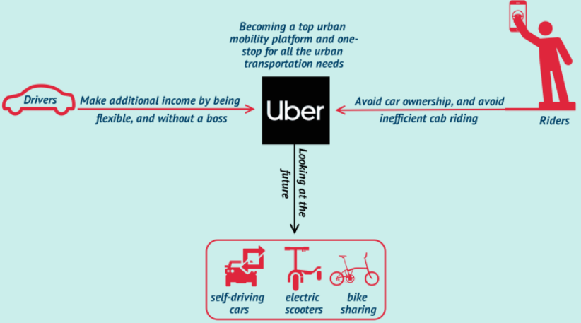
BUSINESS MODEL
Uber uses the two – sided marketplace business model.
Uber's value proposition was created to make up for the scarcity of cab drivers and the inefficiencies of urban mobility.
It attracts two key players:
Drivers.
And riders.

Slide 7
BUSINESS SCENARIO
2

Slide 8
BUSINESS SCENARIO
Forecasting future market demand for Uber ride sharing trips for NYC neighborhood.
Company must consider the market demand when planning their marketing strategies.
With competition in the market, forecasting such demand becomes crucial, as even a slight imbalance can motivate a client to switch providers.
Look at machine learning algorithms, which can be used to predict the demand for user trips in NYC neighborhoods.

Slide 9
MACHINE LEARNING USE
3

Slide 10
USAGE IN PROJECT
By forecasting supply and demand, we would be able to direct partner drivers to areas where demand is high, thus increasing their earnings.
Machine learning will assist in building more robust estimates as well as enabling us to make data-driven marketing decisions for increasing uber cars in hotspots.

Slide 11
DATA CLEANING AND VARIABLES USED
4

Slide 12
DATASET
The datasets are collected from 3 different sources
2 dataset with different year’s NYC uber trips data
https://github.com/fivethirtyeight/uber-tlc-foil-response/tree/master/uber-trip-data
https://www.kaggle.com/c/nyc-taxi-trip-duration/data?select=train.zip
1 dataset with NYC neighborhood geospatial location data
https://data.cityofnewyork.us/City-Government/2010-Neighborhood-Tabulation-Areas-NTAs-/cpf4-rkhq

Slide 13
DATA CLEANING
The second dataset had columns:
Dispatching_base_num
Pickup_date
Affiliated_base_num
LocationID
pickup_longitude
pickup_latitude
The first dataset initially had columns:
Id
vendor_id
pickup_datetime
Dropoff_datetime
passenger_count
pickup_longitude
pickup_latitude
dropoff_longitude
dropoff_latitude
store_and_fwd_flag
trip_duration
Notes:
So initially the dataset which had uber trips data had all these columns, since some of them were not needed in our analysis and model we cleaned our dataset and used the columns that I will show in next slides
We also did datatype conversion for date from string to date type

Slide 14
DATASET TRANSFORMATION
Dataset 1 and 2 with uber trips data
pickup_datetime: date and time when the meter was engaged
pickup_longitude : the longitude where the meter was engaged
pickup_latitude: the latitude where the meter was engaged

Slide 15
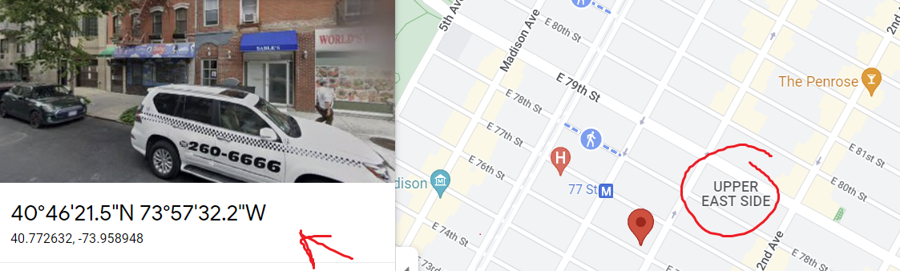
DATASET VARIABLES USED
Dataset with neighborhood geospatial location data
ntaname: neighborhood name
coordinates: set of neighborhood location coordinates
Notes:
By using these 3 different datasets we would be able to achieve our goal to predict the demand for specific neighborhood in new York city

Slide 16
EXPLORATORY DATA ANALYSIS
5

Slide 17
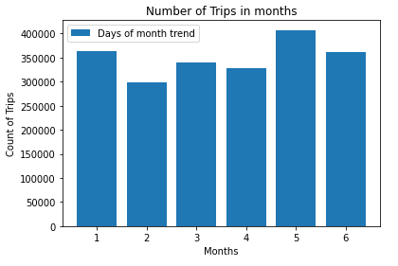
Number of trips in months

Slide 18
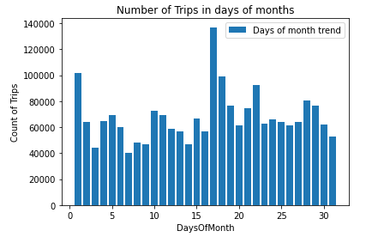
Number of trips in days of month

Slide 19
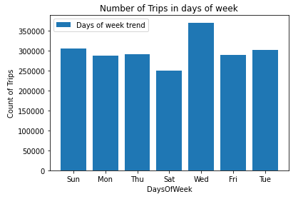
Number of trips in days of week

Slide 20
THANK YOU!
Any questions?

